Slide 1


Jack McLay
06/09/2023

Slide 2

Outline
Executive Summary
Introduction
Methodology
Results
Conclusion
Appendix

Slide 3
Executive Summary
Summary of methodologies
Data Collection
Data Wrangling
Data Analysis w/ Data Visualizations
Data Analysis w/ SQL
Building an Interactive Map (Folium)
Building a Dashboard (Dash)
Preforming Predictive Analysis (ML Classification)
Summary of all results
Results include my findings from Exploratory Data Analysis, Interactive Mapping Analysis, and Predictive Analysis

Slide 4
Introduction
Project background and context
The commercial space age is here, companies are making space travel affordable for everyone. Virgin Galactic is providing suborbital spaceflights. Rocket Lab is a small satellite provider. Blue Origin manufactures sub-orbital and orbital reusable rockets. However, the most successful is SpaceX.
One reason SpaceX can do this is the rocket launches are relatively inexpensive.
SpaceX advertises Falcon 9 rocket launches on its website with a cost of 62 million dollars
While other providers cost upwards of 165 million dollars each.
Much of the savings is because SpaceX can reuse the first stage. Therefore, if we can determine if the first stage will land, we can determine the cost of a launch.
Problems you want to find answers
Therefore, the task of this project is to predict if the first stage of the Falcon 9 rocket will land successfully or crash and burn.

Slide 5

Section 1

Slide 6
Methodology
Executive Summary
Data collection methodology:
The data was collected from a number of different sources including:
SpaceX Rest API
Web Scraping from Wikipedia
Perform data wrangling
Scrubbed the data removing null values and irrelevant data, along with One Hot Encoding (Pandas get_dummies) to prepare fields for ML models.
Perform exploratory data analysis (EDA) using visualization and SQL
Perform interactive visual analytics using Folium and Plotly Dash
Perform predictive analysis using classification models
Including Linear Regression, K-Nearest Neighbor, SVM, and Decision Trees

Slide 7
Data Collection
Describe how data sets were collected.
The SpaceX Launch Site data was collected from SpaceX’s REST API.
This data included details about, the launch pad, rocket used, payload, failures, successes, dates, etc.
Our other source of data involved web scrapping data about the Falcon 9 launches from Wikipedia using Beautiful Soup.
SpaceX REST API Call
Call HTML Response from Wikipedia
Parse JSON response
Parse Data using Beautiful Soup
Filter Data and Eliminate Null Values
Filter Data and Create a DataFrame
Export to CSV
Export to CSV

Slide 8
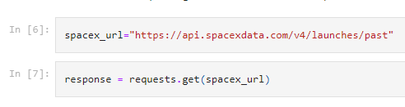
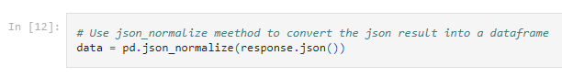
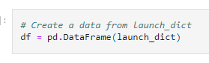
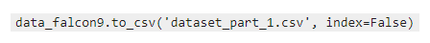
Data Collection – SpaceX API
Call the API
Convert to JSON:
Clean Data using Functions: getBoosterVersion(data), getLaunchSite(data), getPayloadData(data), getCoreData(data)
Create DataFrame from Cleaned JSON:
Export to a CSV
Data collection with SpaceX REST calls and Code examples:
https://github.com/jackmclay/Applied-Data-Science-Capstone/blob/main/jupyter-labs-spacex-data-collection-api.ipynb

Slide 9
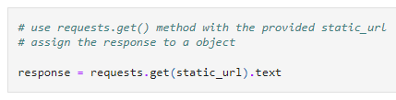
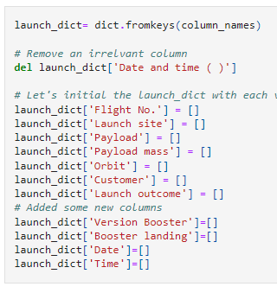
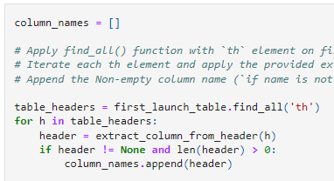
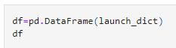
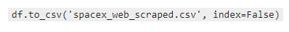
Data Collection - Scraping
Web scraping from Falcon 9 Wikipedia with Code examples:
https://github.com/jackmclay/Applied-Data-Science-Capstone/blob/main/jupyter-labs-webscraping.ipynb
Get Response from Static URL:
Create BeautifulSoup Parser:
Find tables and get column names:
Create dictionary:
Convert to a DataFrame then CSV:

Slide 10
Data Wrangling
Calculated sum of Null values per column
Calculated the number of launches on each site
Calculated the number and occurrences of each orbit
Calculated the number and occurrences of each mission outcome
Created a landing outcome label
Fixed Null Values
https://github.com/jackmclay/Applied-Data-Science-Capstone/blob/main/labs-jupyter-spacex-data_wrangling_jupyterlite.jupyterlite.ipynb

Slide 11
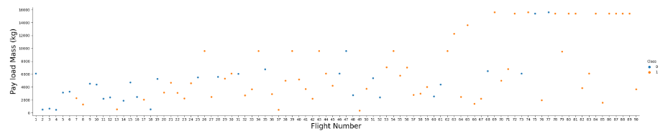
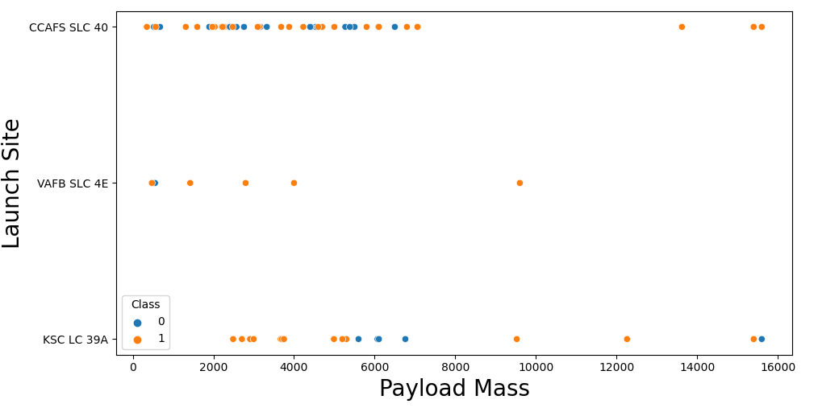
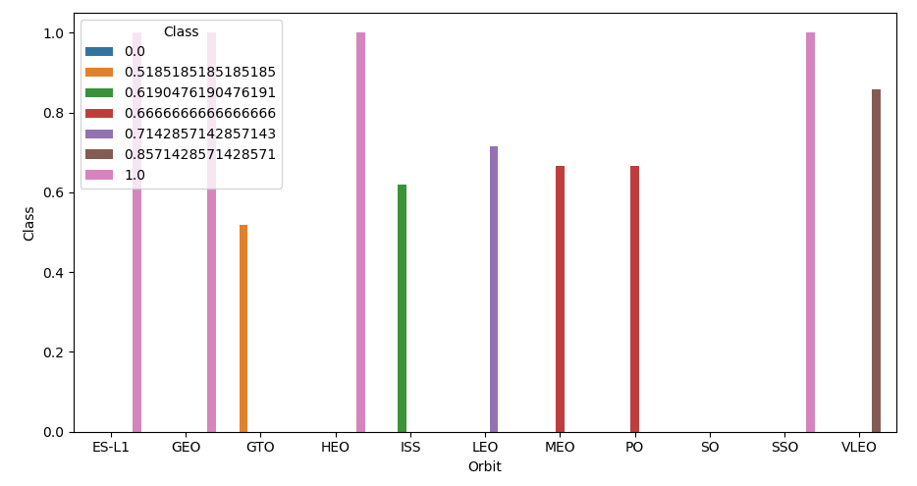
EDA with Data Visualization
https://github.com/jackmclay/Applied-Data-Science-Capstone/blob/main/eda-dataviz.ipynb.jupyterlite.ipynb

Slide 12
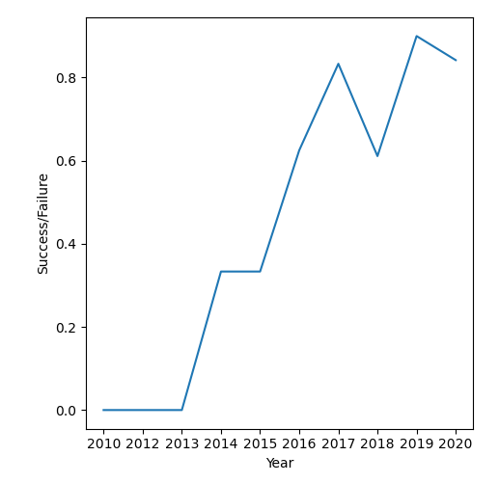
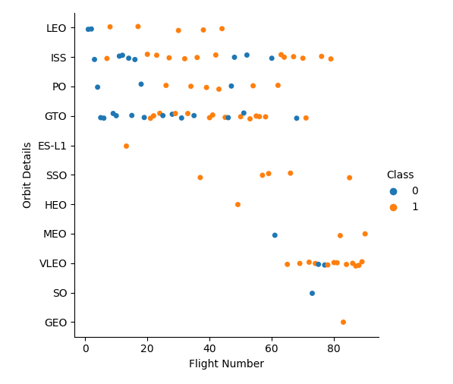
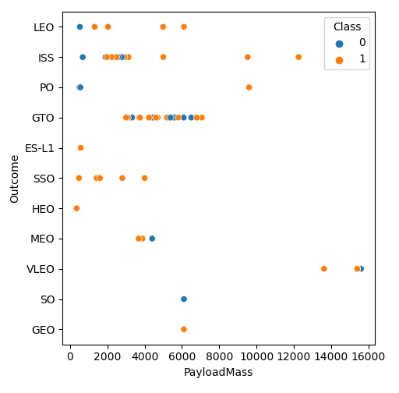
EDA with Data Visualization
https://github.com/jackmclay/Applied-Data-Science-Capstone/blob/main/eda-dataviz.ipynb.jupyterlite.ipynb

Slide 13
EDA with SQL
SQL Queries Preformed:
Display the names of the unique launch sites in the space mission
Display 5 records where launch sites begin with the string 'CCA'
Display the total payload mass carried by boosters launched by NASA (CRS)
Display average payload mass carried by booster version F9 v1.1
List the date when the first successful landing outcome in ground pad was achieved.
List the names of the boosters which have success in drone ship and have payload mass greater than 4000 but less than 6000
List the total number of successful and failure mission outcomes
List the names of the booster_versions which have carried the maximum payload mass. Use a subquery
List the records which will display the month names, failure landing_outcomes in drone ship ,booster versions, launch_site for the months in year 2015.
Rank the count of successful landing_outcomes between the date 04-06-2010 and 20-03-2017 in descending order.
https://github.com/jackmclay/Applied-Data-Science-Capstone/blob/main/eda-sql-coursera_sqllite.ipynb

Slide 14
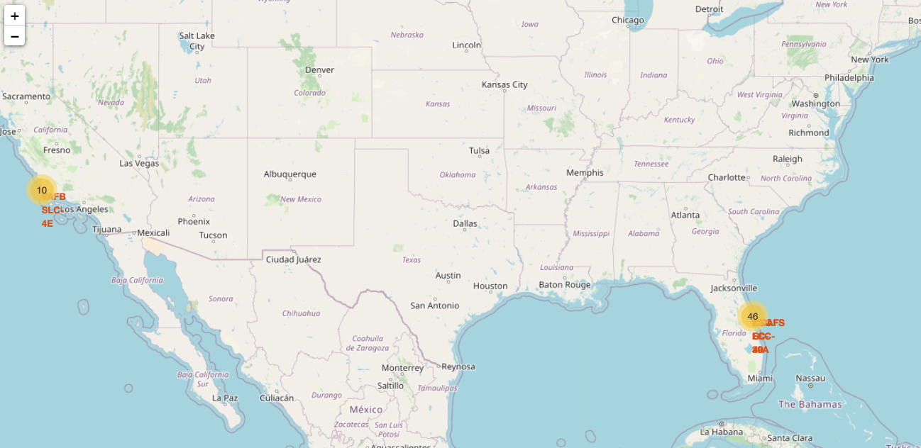
Build an Interactive Map with Folium
These markers were added to the map to explore why launch sites are close to the equator, coast, railways, highways, and far(ish) from cities/towns.
https://github.com/jackmclay/Applied-Data-Science-Capstone/blob/main/lab_jupyter_launch_site_location.jupyterlite%20(1).ipynb

Slide 15
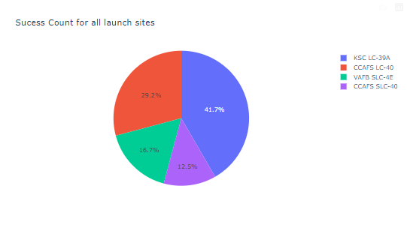
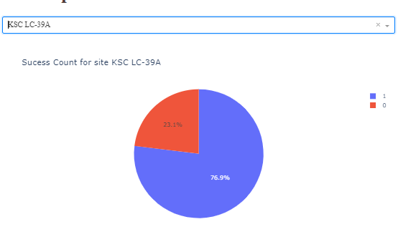
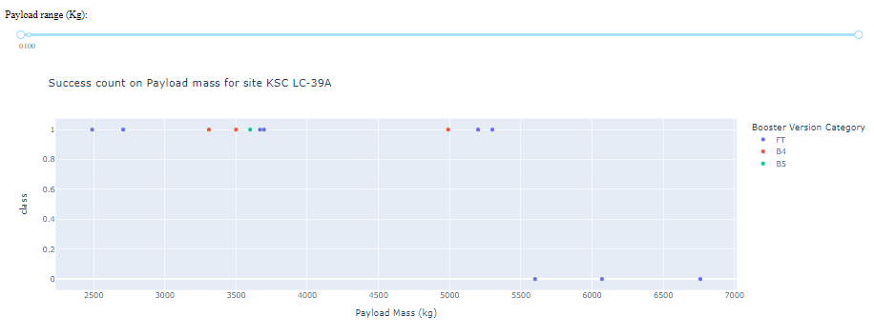
Build a Dashboard with Plotly Dash
https://github.com/jackmclay/Applied-Data-Science-Capstone/blob/main/spacex_dash_app.py
KSC LC-39A had the most successful launches
Out of all the launches at KSC LC-39A 23% failed
All the launches that failed had a weight higher than 5000 kg

Slide 16
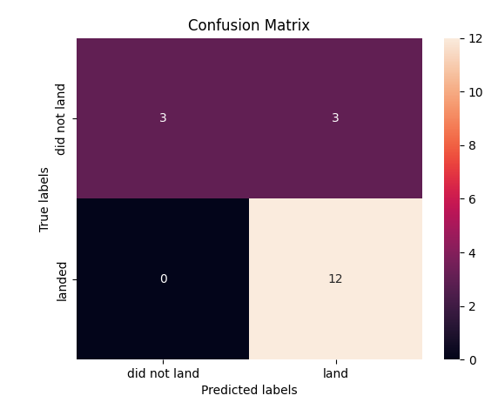
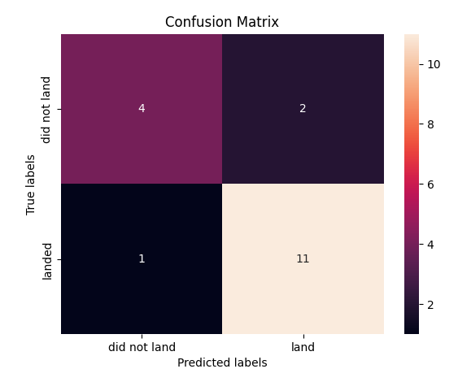
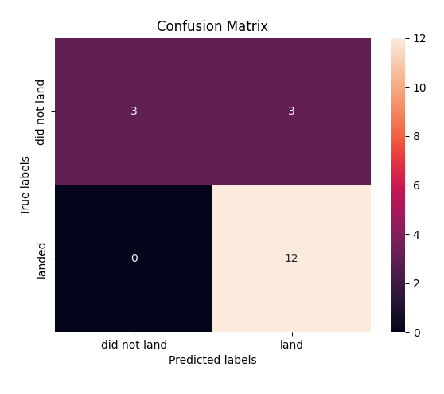
Predictive Analysis (Classification)
LogReg
SVM
All the machine learning models preformed similarly. With all the accuracies for each model being 83.34%
Only outlier being the Decision Tree that is slightly different.
https://github.com/jackmclay/Applied-Data-Science-Capstone/blob/main/SpaceX_Machine_Learning_Prediction.jupyterlite.ipynb
Decision Tree
KNN

Slide 17
Results
According to our exploratory data analysis rockets with lower payload weights tend to be more successful than heavier attempts.
As SpaceX continues to be successful in there missions the cost of space travel will continue to decrease since rockets are more reliable and renewable.
The most successful launches were from the KSC LC-39A launch site with over 70% of there launches being successful.
In terms of prediction, KNN, SVM, and Log Regression all preformed well with a decision tree being the worst out of the four.

Slide 18

Section 2

Slide 19
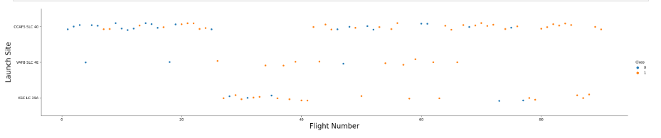
Flight Number vs. Launch Site
There have been significantly more launches from CCAFS SLC 40 than any other site.
With a gap in flight numbers between 25 and 40.

Slide 20
Payload vs. Launch Site
CCAFS SLC 40 launched with a majority of there payload weight under 8,000 kg.
While the other two launch sites have more diverse launch weights.

Slide 21
Success Rate vs. Orbit Type
ES-L1, GEO, HEO, and SSO orbit had the highest average success across the board.
While GTO had the lowest success average.

Slide 22
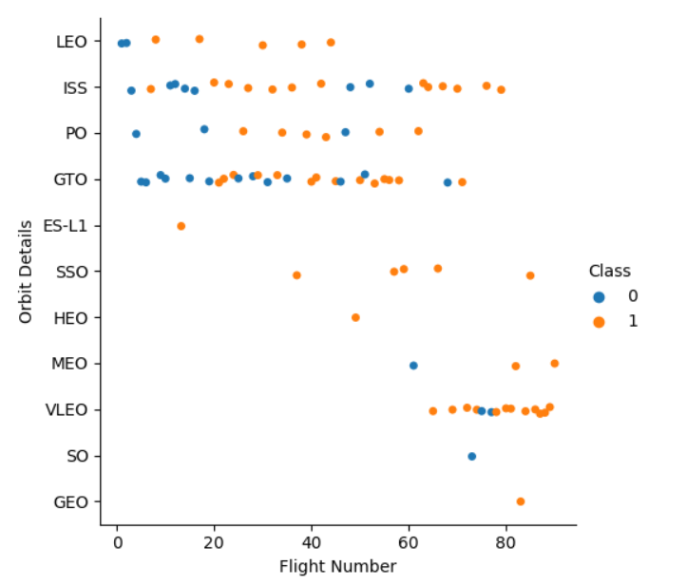
Flight Number vs. Orbit Type
GEO, SO, and VELO all have flight numbers greater than 60.
LEO, ISS, PO, and GTO all have flight numbers ranging from 0-80

Slide 23
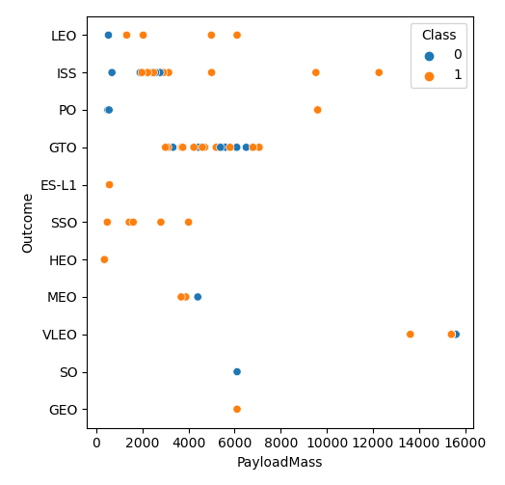
Payload vs. Orbit Type
There is a correlation between GTO orbits and the payload mass being between 3,500 - 8,000 kgs.
There is also a correlation between and ISS orbit and a payload mass between 2,000 and 4,000 kgs.

Slide 24
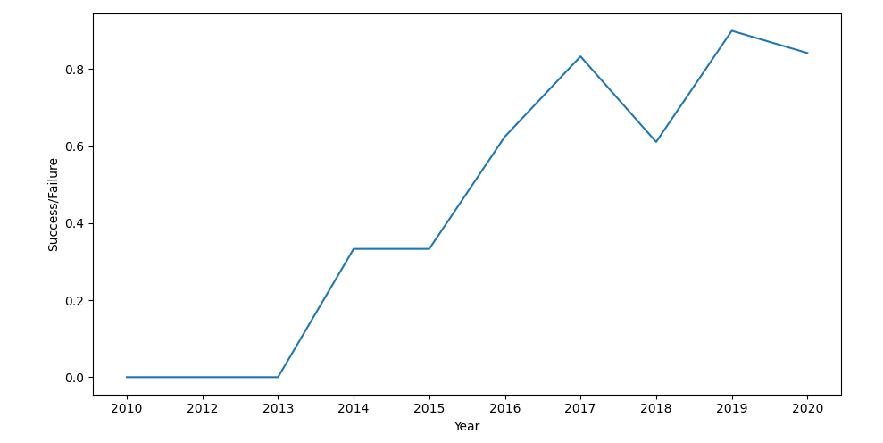
Launch Success Yearly Trend
Over the course of 10 years launch success rates have increased and continue to trend in that direction.

Slide 25
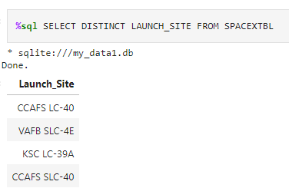
All Launch Site Names
Find the names of the unique launch sites

Slide 26
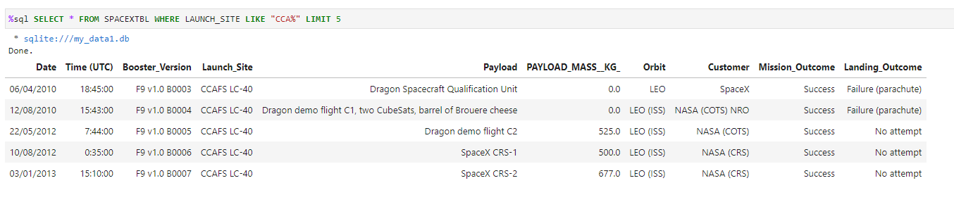
Launch Site Names Begin with 'CCA'
Find 5 records where launch sites begin with `CCA`

Slide 27
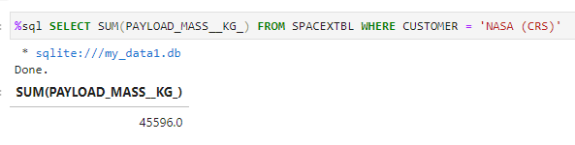
Total Payload Mass
Calculate the total payload carried by boosters from NASA

Slide 28
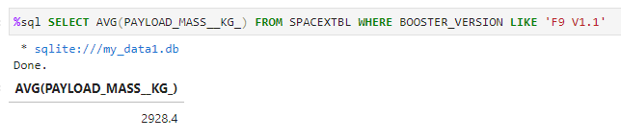
Average Payload Mass by F9 v1.1
Calculate the average payload mass carried by booster version F9 v1.1

Slide 29
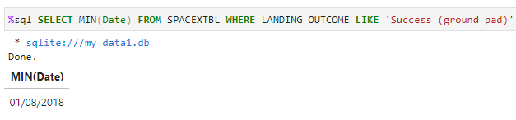
First Successful Ground Landing Date
Find the dates of the first successful landing outcome on ground pad

Slide 30
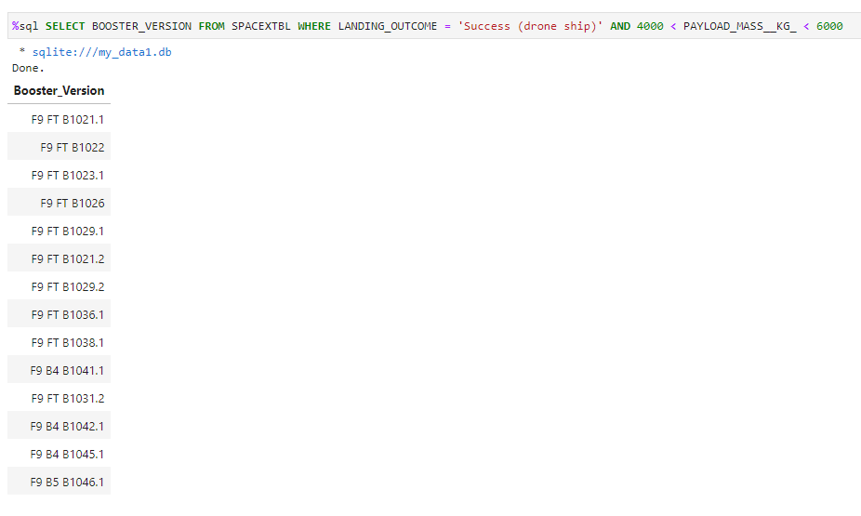
Successful Drone Ship Landing with Payload between 4000 and 6000
List the names of boosters which have successfully landed on drone ship and had payload mass greater than 4000 but less than 6000

Slide 31
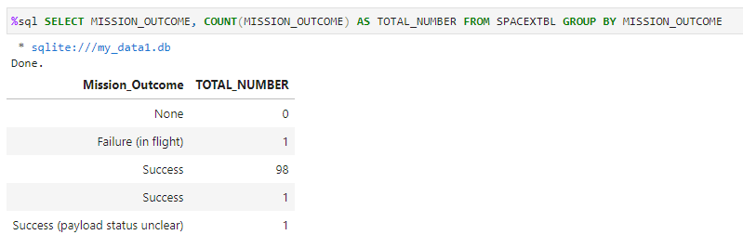
Total Number of Successful and Failure Mission Outcomes
Calculate the total number of successful and failure mission outcomes

Slide 32
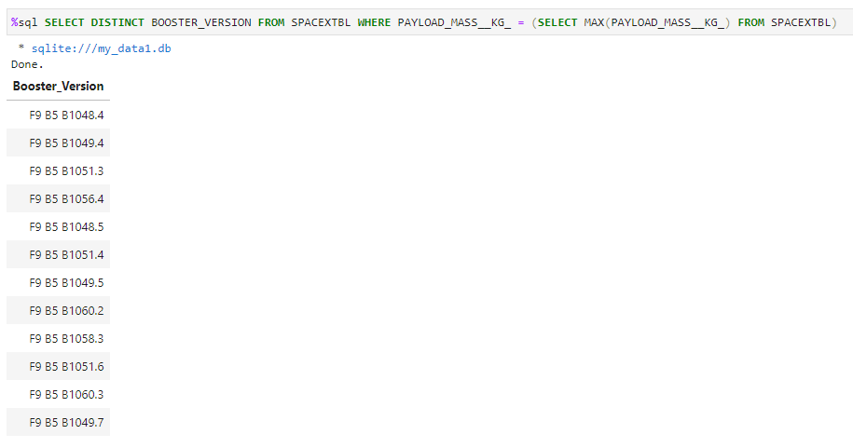
Boosters Carried Maximum Payload
List the names of the booster which have carried the maximum payload mass

Slide 33
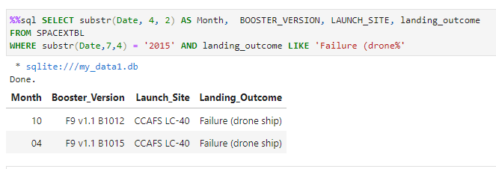
2015 Launch Records
List the failed landing_outcomes in drone ship, their booster versions, and launch site names for in year 2015

Slide 34
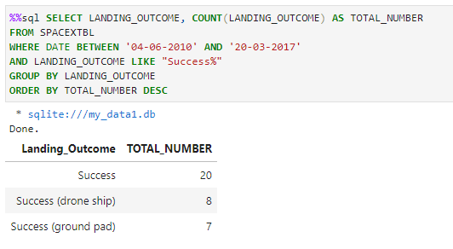
Rank Landing Outcomes Between 2010-06-04 and 2017-03-20
Rank the count of landing outcomes (such as Success (drone ship) or Success (ground pad)) between the date 2010-06-04 and 2017-03-20, in descending order

Slide 35

Section 3

Slide 36
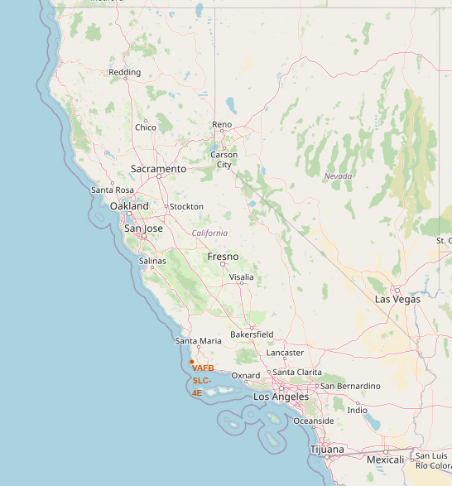
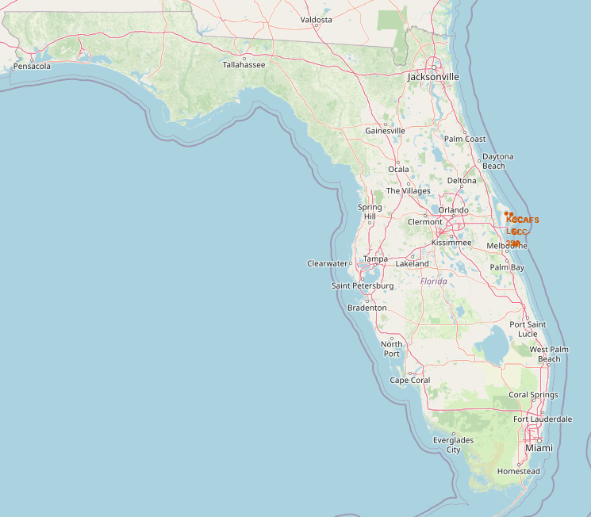
All Launch Site Location on a Global Map

Slide 37
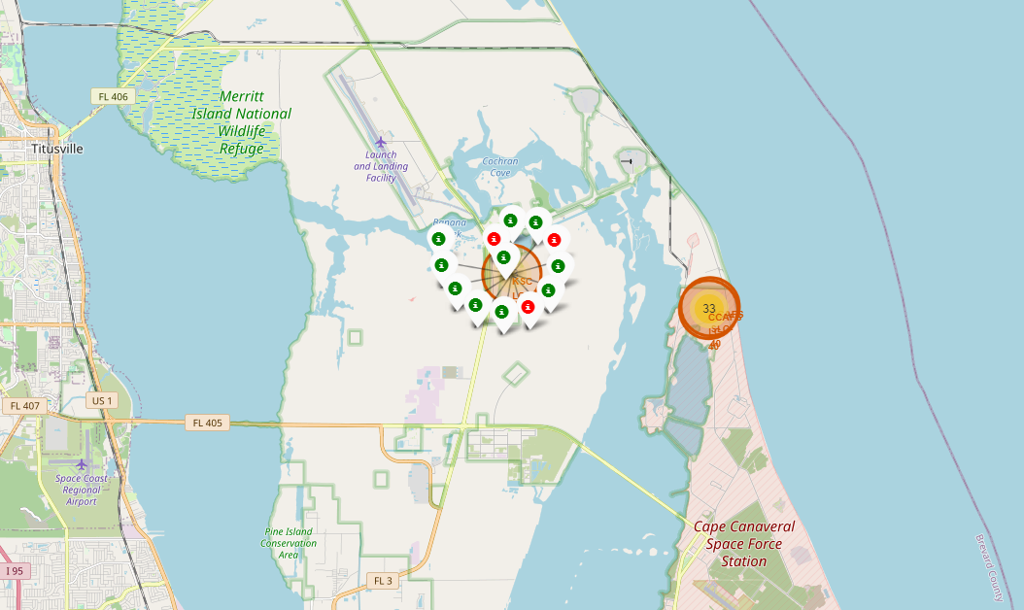
Color-Labeled Launch Outcomes on the Map

Slide 38
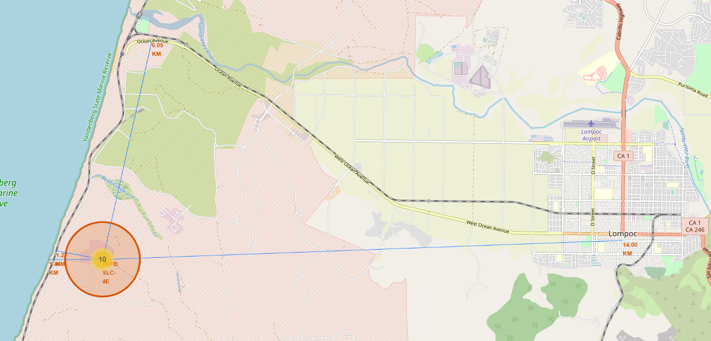
Launch Site Proximity to Railway, Highway, Coastline, with Distance Calculated and Displayed

Slide 39

Section 4

Slide 40
Launch Success Percentage for all Sites
KSC LC-39A has the greatest success at 41.7% followed by CCAFS LC-40 at 29.2%

Slide 41
Launch Site with the Highest Success Percentage
KSC LC-39A is successful 3/4th of the time there is a launch

Slide 42
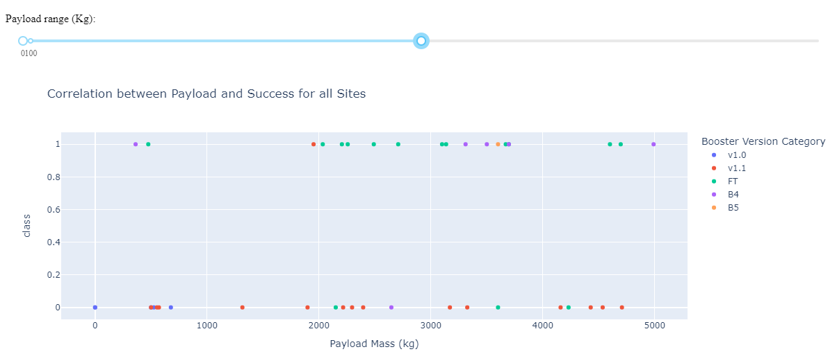
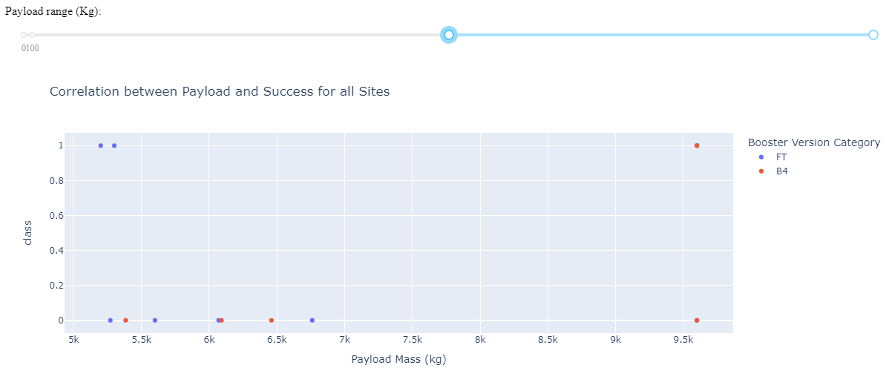
Payload Mass (kg) vs. Launch Outcome
There is an even split of failure and success across all sites from payloads between 0 and 5,000 kgs.
However, the number of failures greatly out weight the successes once the weight begins to exceed 5,000 kgs

Slide 43

Section 5

Slide 44
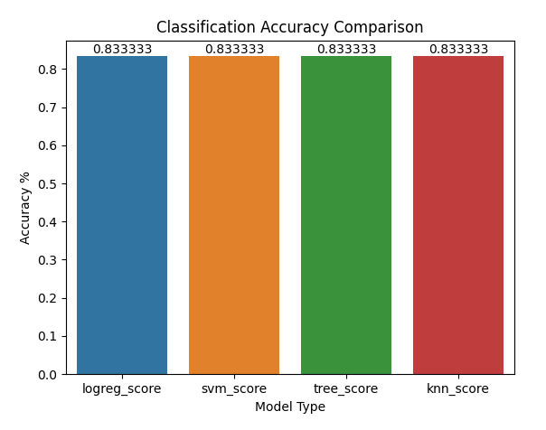
Classification Accuracy
All models have an equal accuracy in terms of determining success or failure of a landing.

Slide 45
Confusion Matrix
LogReg
SVM
Our confusion Matrix show that all the classification models except for Decision Tree provide the same classification results.
Therefore, any of the models except for a Decision Tree could be effective in predicting landing success.
Decision Tree
KNN

Slide 46
Conclusions
KNN, SVM, and Log Regression were the best at predicting landing accuracy for this data.
Per the exploratory data analysis, we can determine that payload mass is a large factor in determining the outcome of a landing.
SSO, ES L1, HEO, and GEO orbits lead to the most successful landings.
While rockets launched from KSC LC-39A are the most successful at landing, mostly due to the number of launches with low payloads.
Overtime as rockets become more advanced the amount of successful landing should increase as a result.

Slide 47
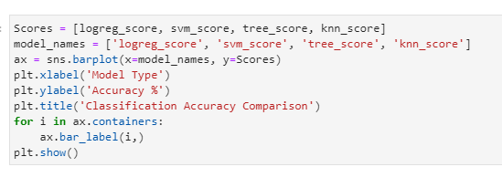
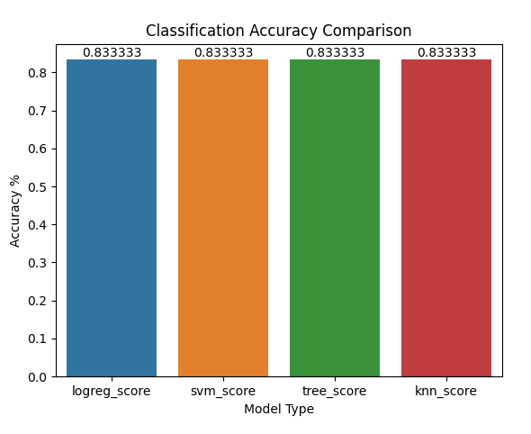
Appendix
I created this Bar chart to compare accuracy
Created Data Sets:
https://github.com/jackmclay/Applied-Data-Science-Capstone/blob/main/spacex_web_scraped.csv
https://github.com/jackmclay/Applied-Data-Science-Capstone/blob/main/spacex_launch_dash.csv
https://github.com/jackmclay/Applied-Data-Science-Capstone/blob/main/dataset_part_1.csv

Slide 48


